Slide 1
CSC 3210 Computer Organization and Programming
Lab Work 6
Georgia State University
Spring 2024

Slide 2
Learning Objective
Data Transfer,
Arithmetic instructions with variables

Slide 3
Disclaimer
The process shown in these slides might not work in every single computer due to Operating system version, Microsoft Visual Studio versions and everything.
If you find any unusual error, you can inform the instructor.
Instructor will help you resolve the issue.

Slide 4
Lab Work 6 Instructions
Lab 6(a): Movzx and movsx instructions
Lab 6(b): Direct-Offset Addressing
Lab 6(c): xchg instruction
Due Date: posted on iCollege

Slide 5
Plan early …
You have one week time to submit the lab
Start early
If you have issues
Email TA or instructor
Stop by during office hours
Start working at the last moment is not a good idea.
Appendix shows how to create a new project.

Slide 6
Lab 6(a)
Submission

Slide 7
Movzx and Movsx
.data
myByte1 BYTE 9Bh
.code
mov bx, 0A69Bh
movzx eax, bx ;EAX =
movzx eax, myByte1 ;EAX=
mov bx,0A69Bh
movsx eax,bx ;EAX =
Create a new project to run the following program.
Build and run the program using the debugger
Examine the content of the registers

Slide 8
Submission Instruction- 6(a)
Debug through each line of your code.
Execute the instruction
Take a screenshot of the code and register window
Record the line number, instruction, Register values in the answer sheet.
Also add the screenshot
Then explain the register contents.

Slide 9
Lab 6(b)
Submission

Slide 10
Data Transfer Instructions: Direct-Offset Addressing
Create a new Project to run the following program.
Build and run the program using the debugger
Examine the content of the registers
.data
arrayD DWORD 10000h,20000h, 30000h
.code
; Direct-Offset Addressing (doubleword array):
mov eax,arrayD ; EAX =
mov ebx,[arrayD+4] ; EBX =
mov edx,[arrayD+8] ; EDX =

Slide 11
Submission Instruction – 6(b)
Debug through each line of your code.
Execute the instruction
Take a screenshot of the code and register window
Record the line number, instruction, Register values in the answer sheet.
Also add the screenshot
Then explain the register contents.

Slide 12
Xchg instruction
A review

Slide 13
XCHG instruction
.data
val1 WORD 1000h
val2 WORD 2000h
.code
; Memory-to-memory exchange:
mov ax,val1 ; AX =
xchg ax,val2 ; AX= , val2=
mov val1,ax ; val1 =

Slide 14
Exchange item in an array
Create a new project to run the following program.
Build and run the program using the debugger
Examine the content of the registers
rearranges the values of three doubleword values in the following array as:
1,2,3 ----------→ 3, 1, 2.
See next slide -→

Slide 15
Data Transfer Instructions : Direct-Offset Operands
.data
arrayD DWORD 1,2,3
Step1: copy the FIRST value into EAX and exchange it with the value in the SECOND position.
mov eax, arrayD
xchg eax, [arrayD+4]
Step 2: Exchange EAX with the THIRD array value and copy the value in EAX to the FIRST array position.
xchg eax,[arrayD+8]
mov arrayD,eax

Slide 16
Lab 6(c)
Submission

Slide 17
Submission instruction – 6(c)
Create a new project to run the following program
Declare an array:
arrayB WORD 1,2,3,4
Write code to Rearrange the array as follows:
3,4,2,1
Debug the code until you reach “INVOKE ExitProcess, 0”
Add the screenshot of your code in the answer sheet.

Slide 18
Appendix
Create a Project

Slide 19
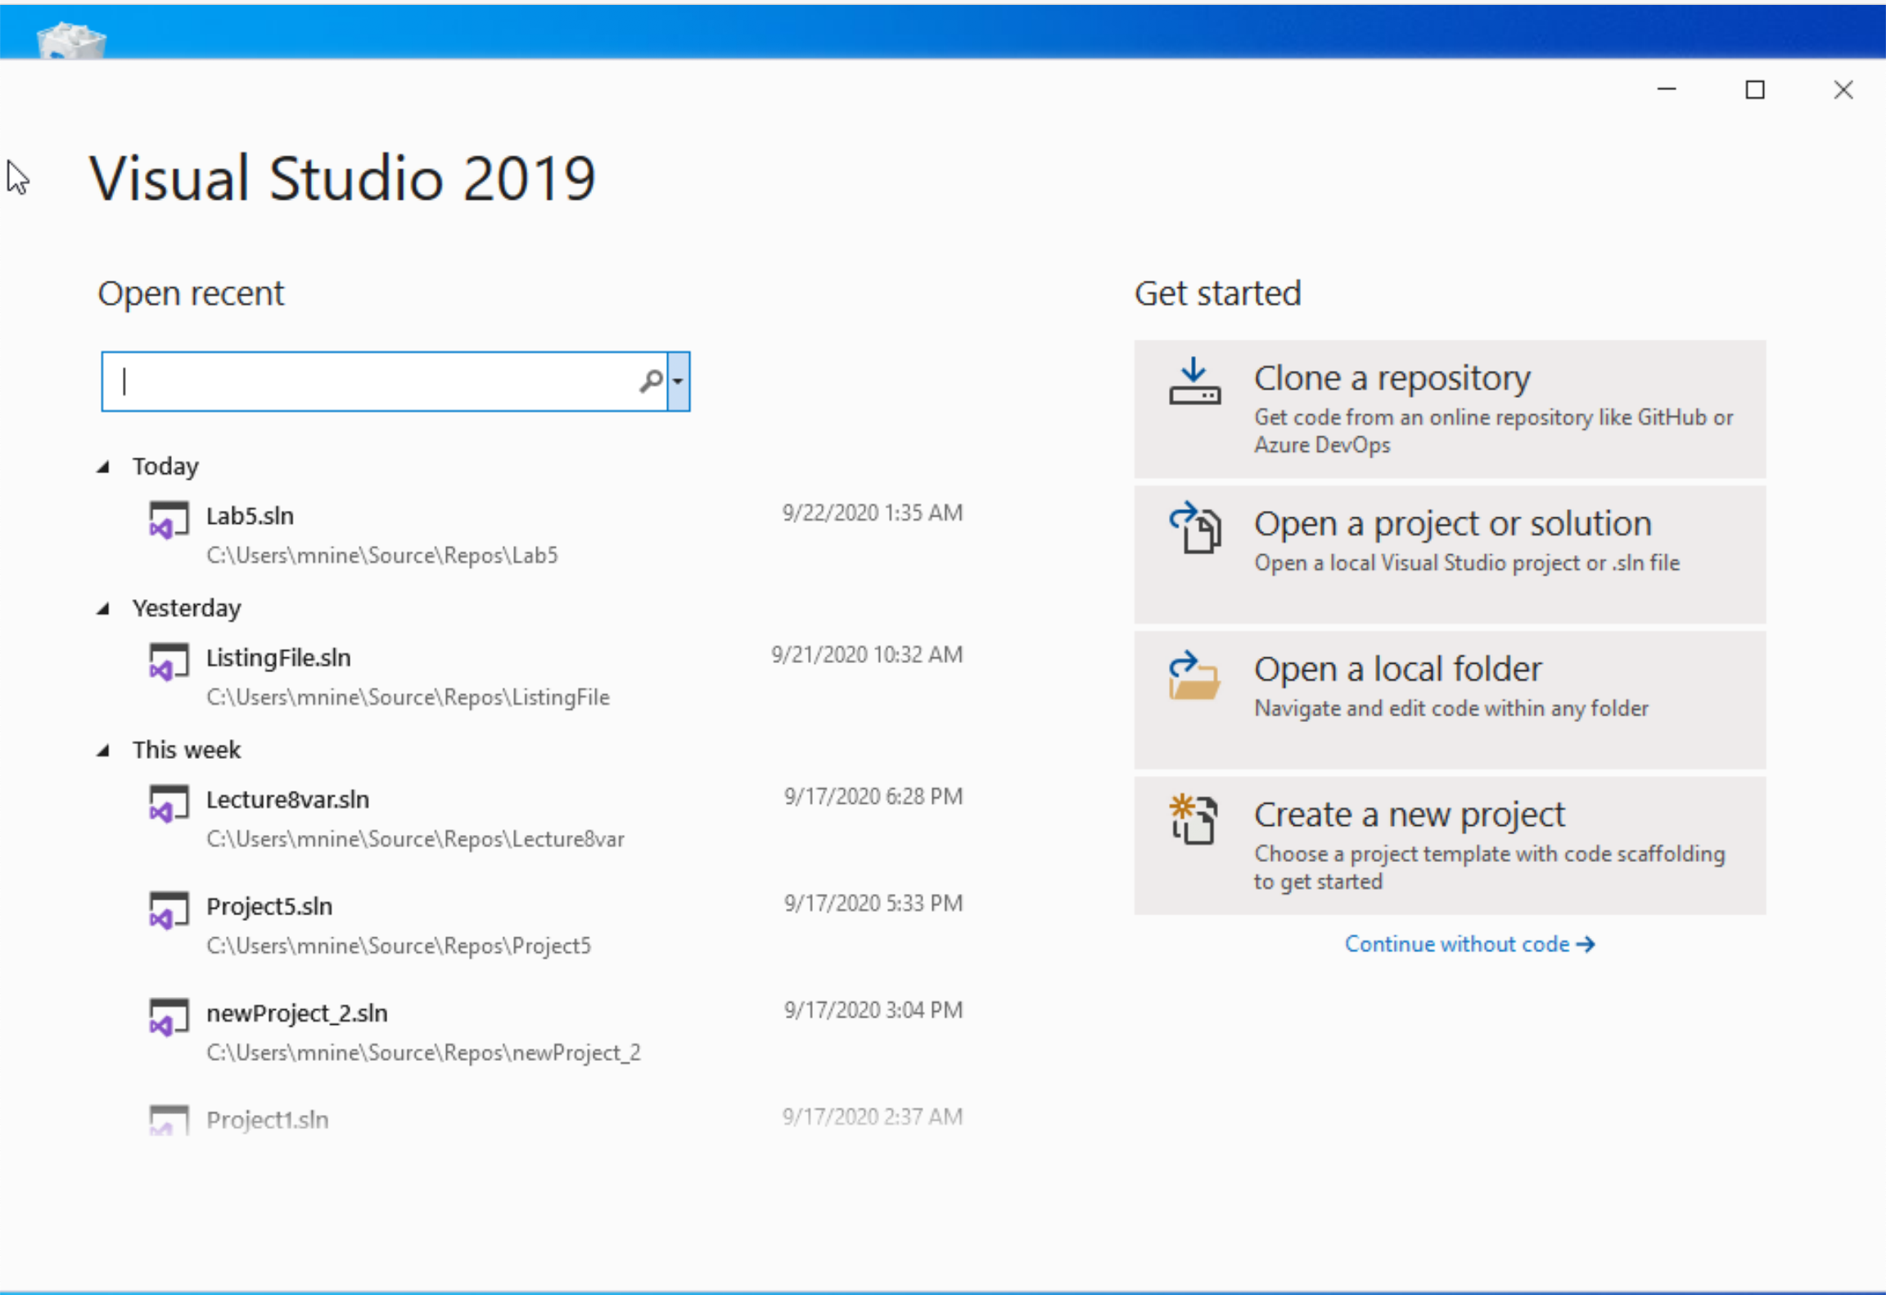


Step 1: Create a project (1)
Start Visual Studio
Click Create a new Project

Slide 20
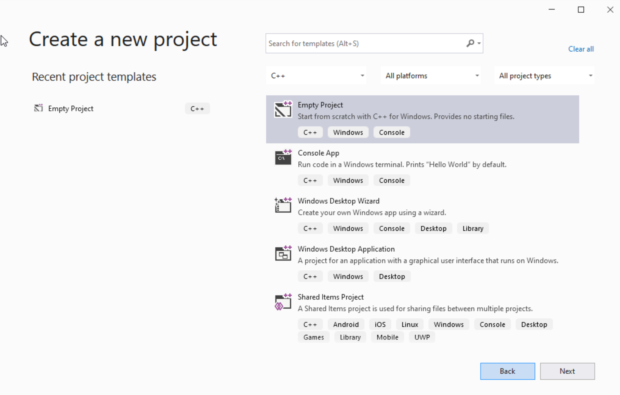




Step 1: Create a project (2)
Select C++ as language
Select Empty Project
Click Next

Slide 21
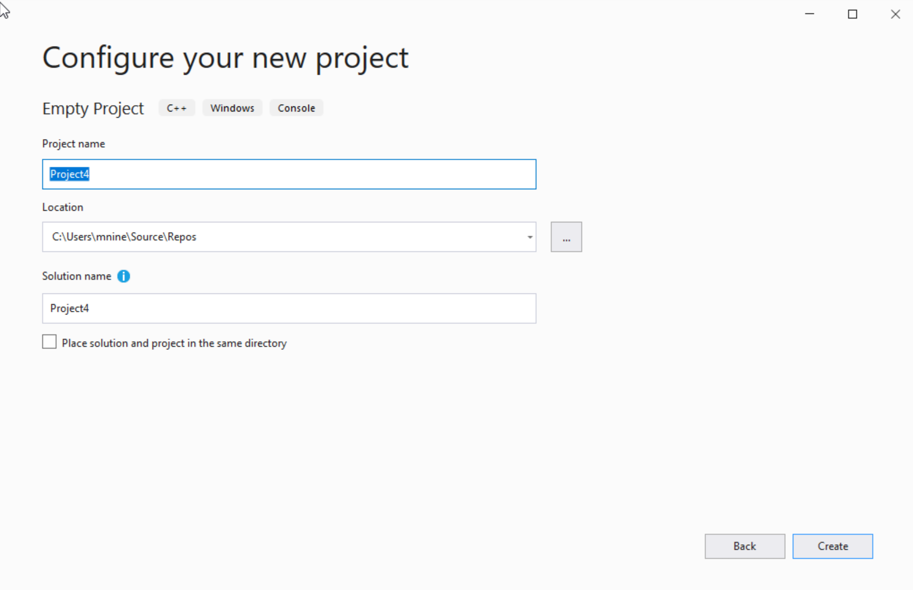

Step 1: Create a project (3)
You can change the project
name as you like
Also, you can change the
project location
Click Next

Slide 22
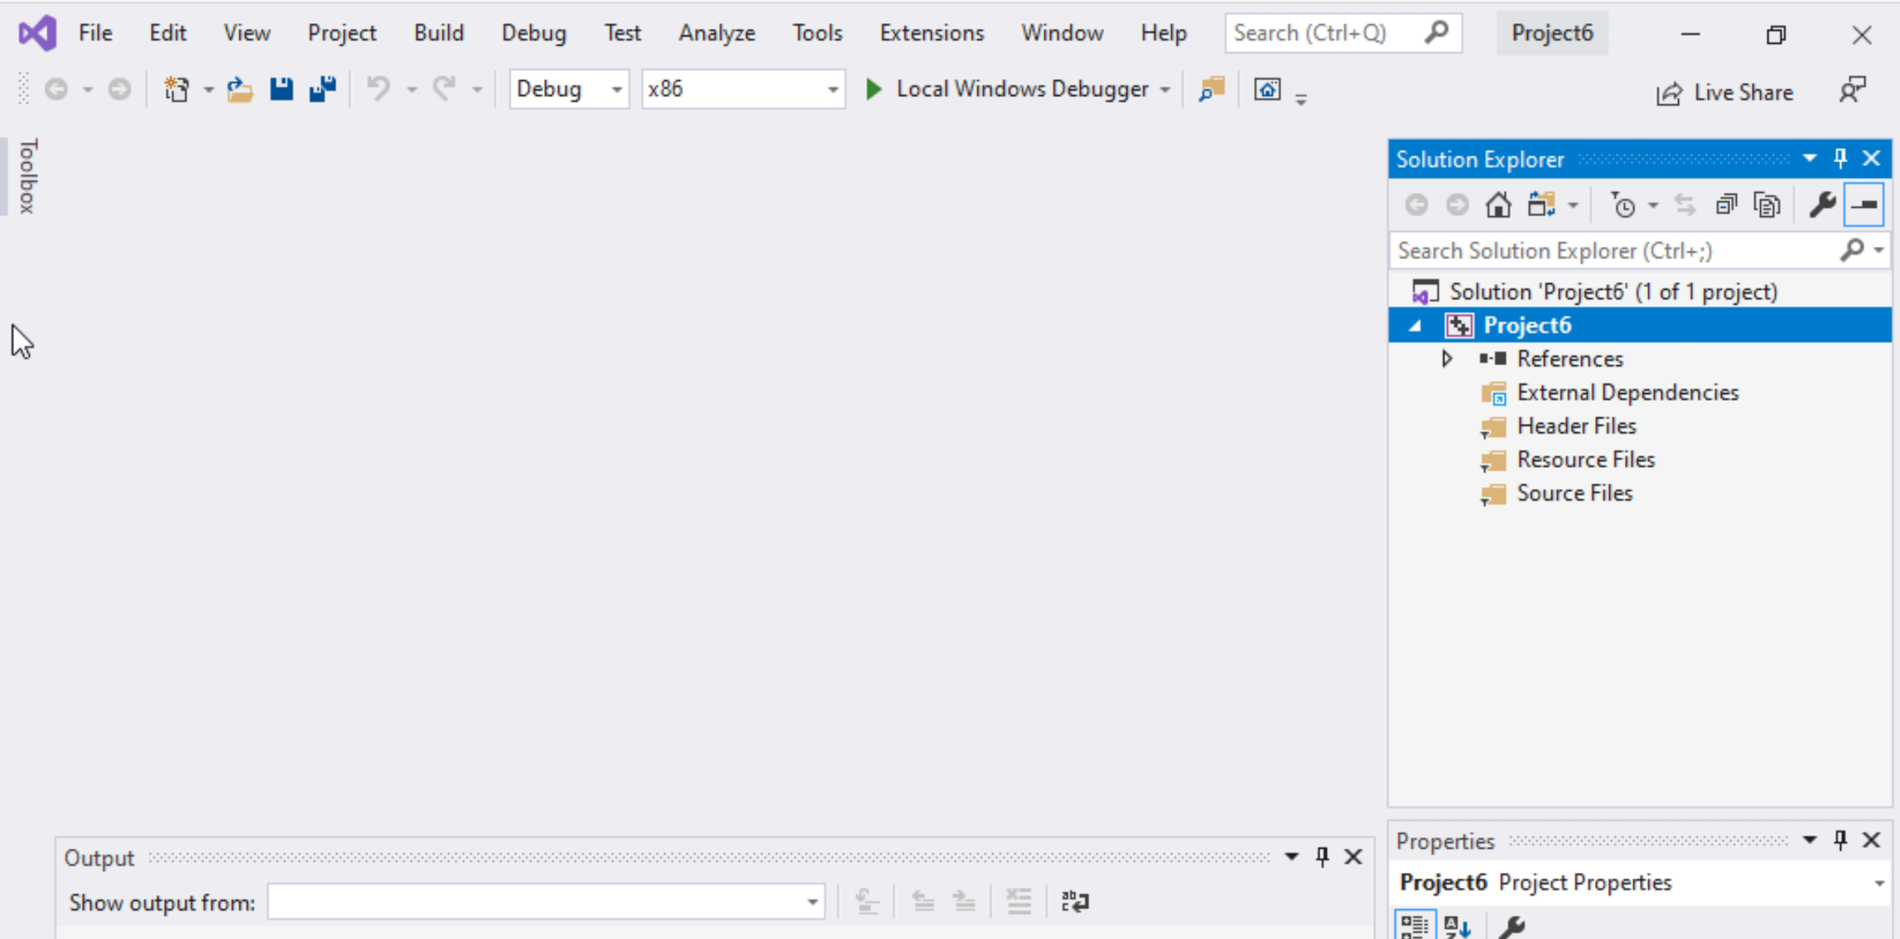
Step 1: Create a project (4)
Delete the
Following folders:
Header files
Resources Files, and
Source Files

Slide 23
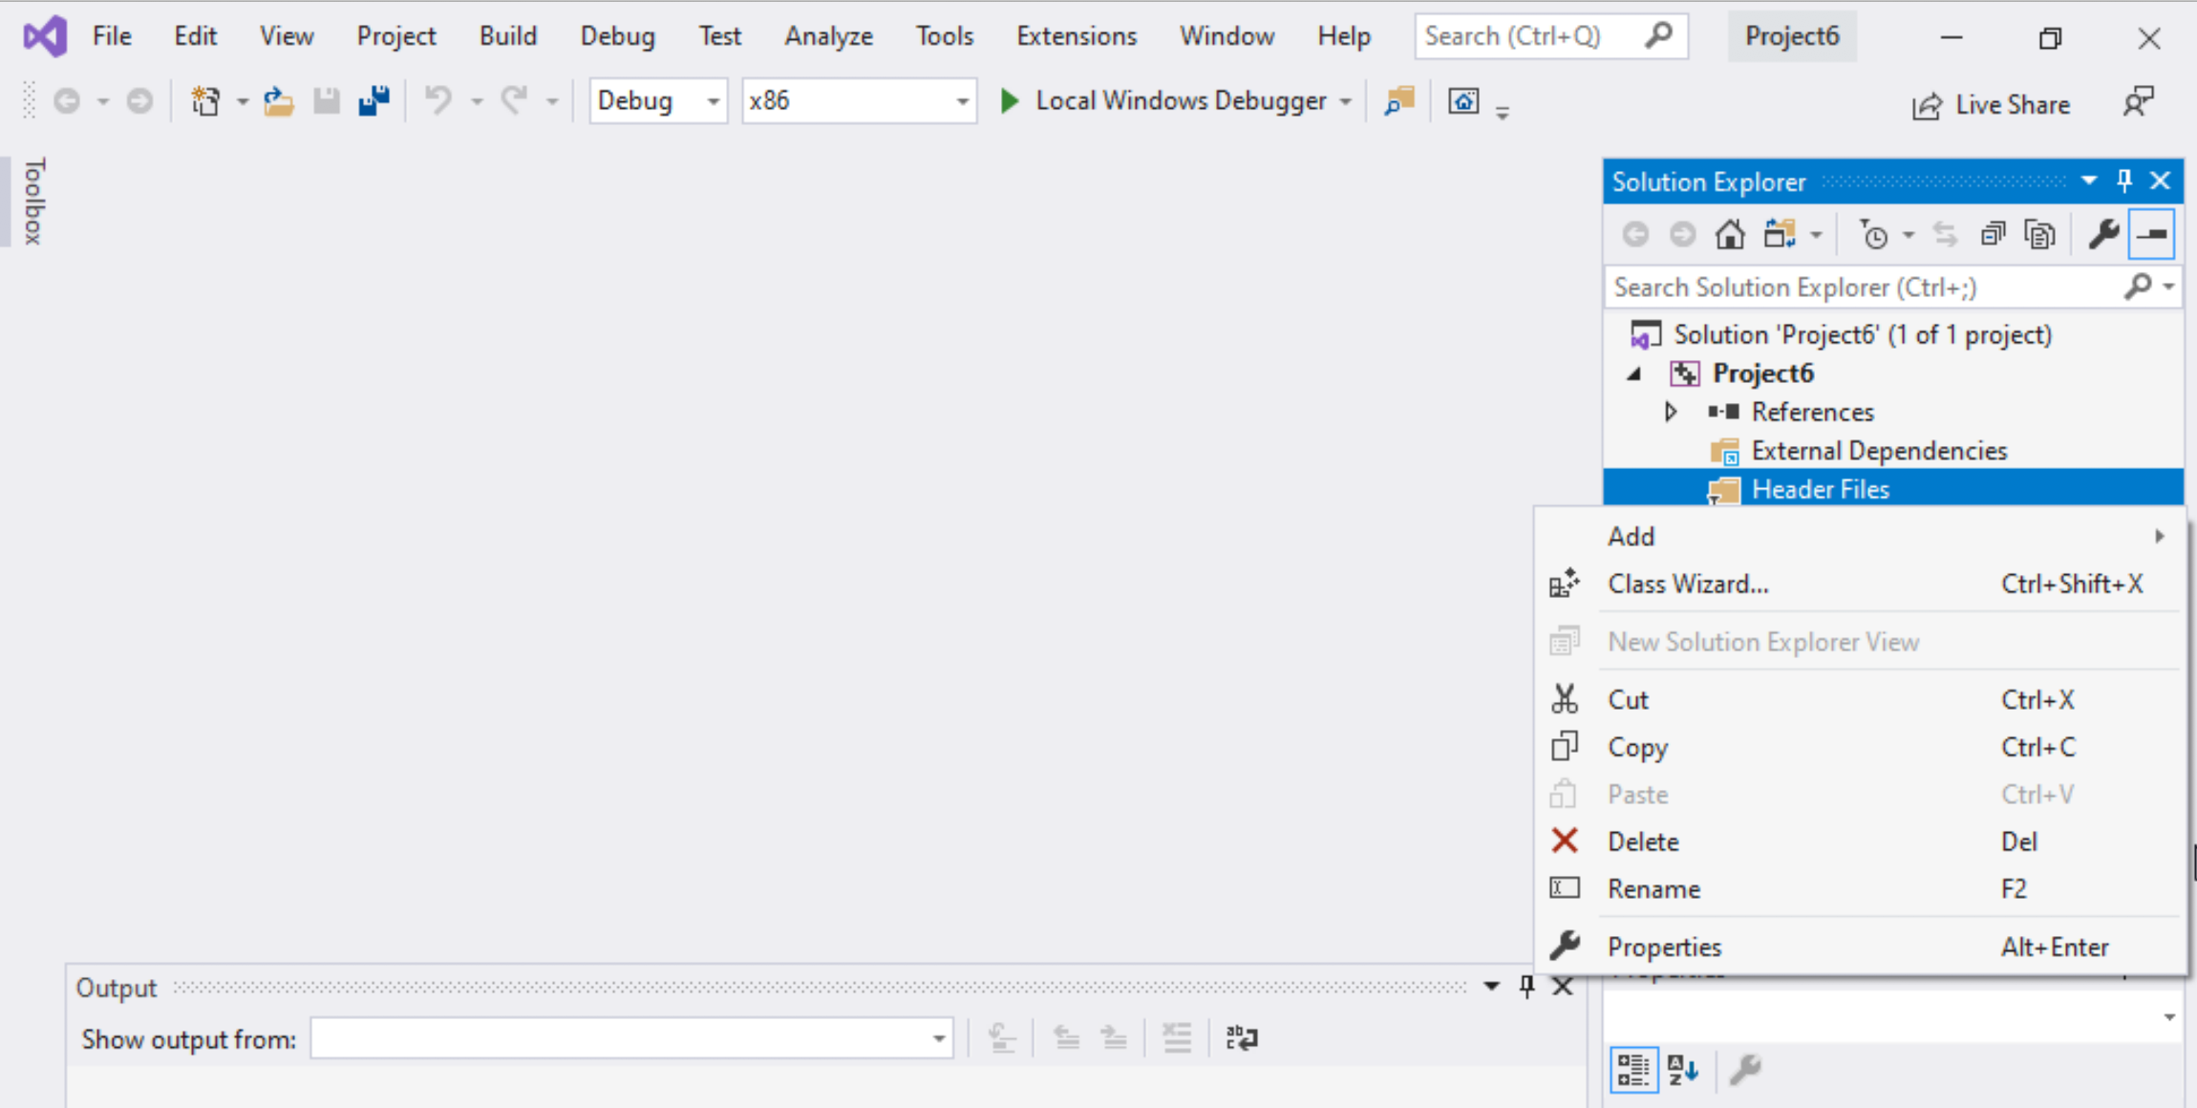
Step 1: Create a project (5)
To delete :
Select the folders
Right click on it
Select delete

Slide 24
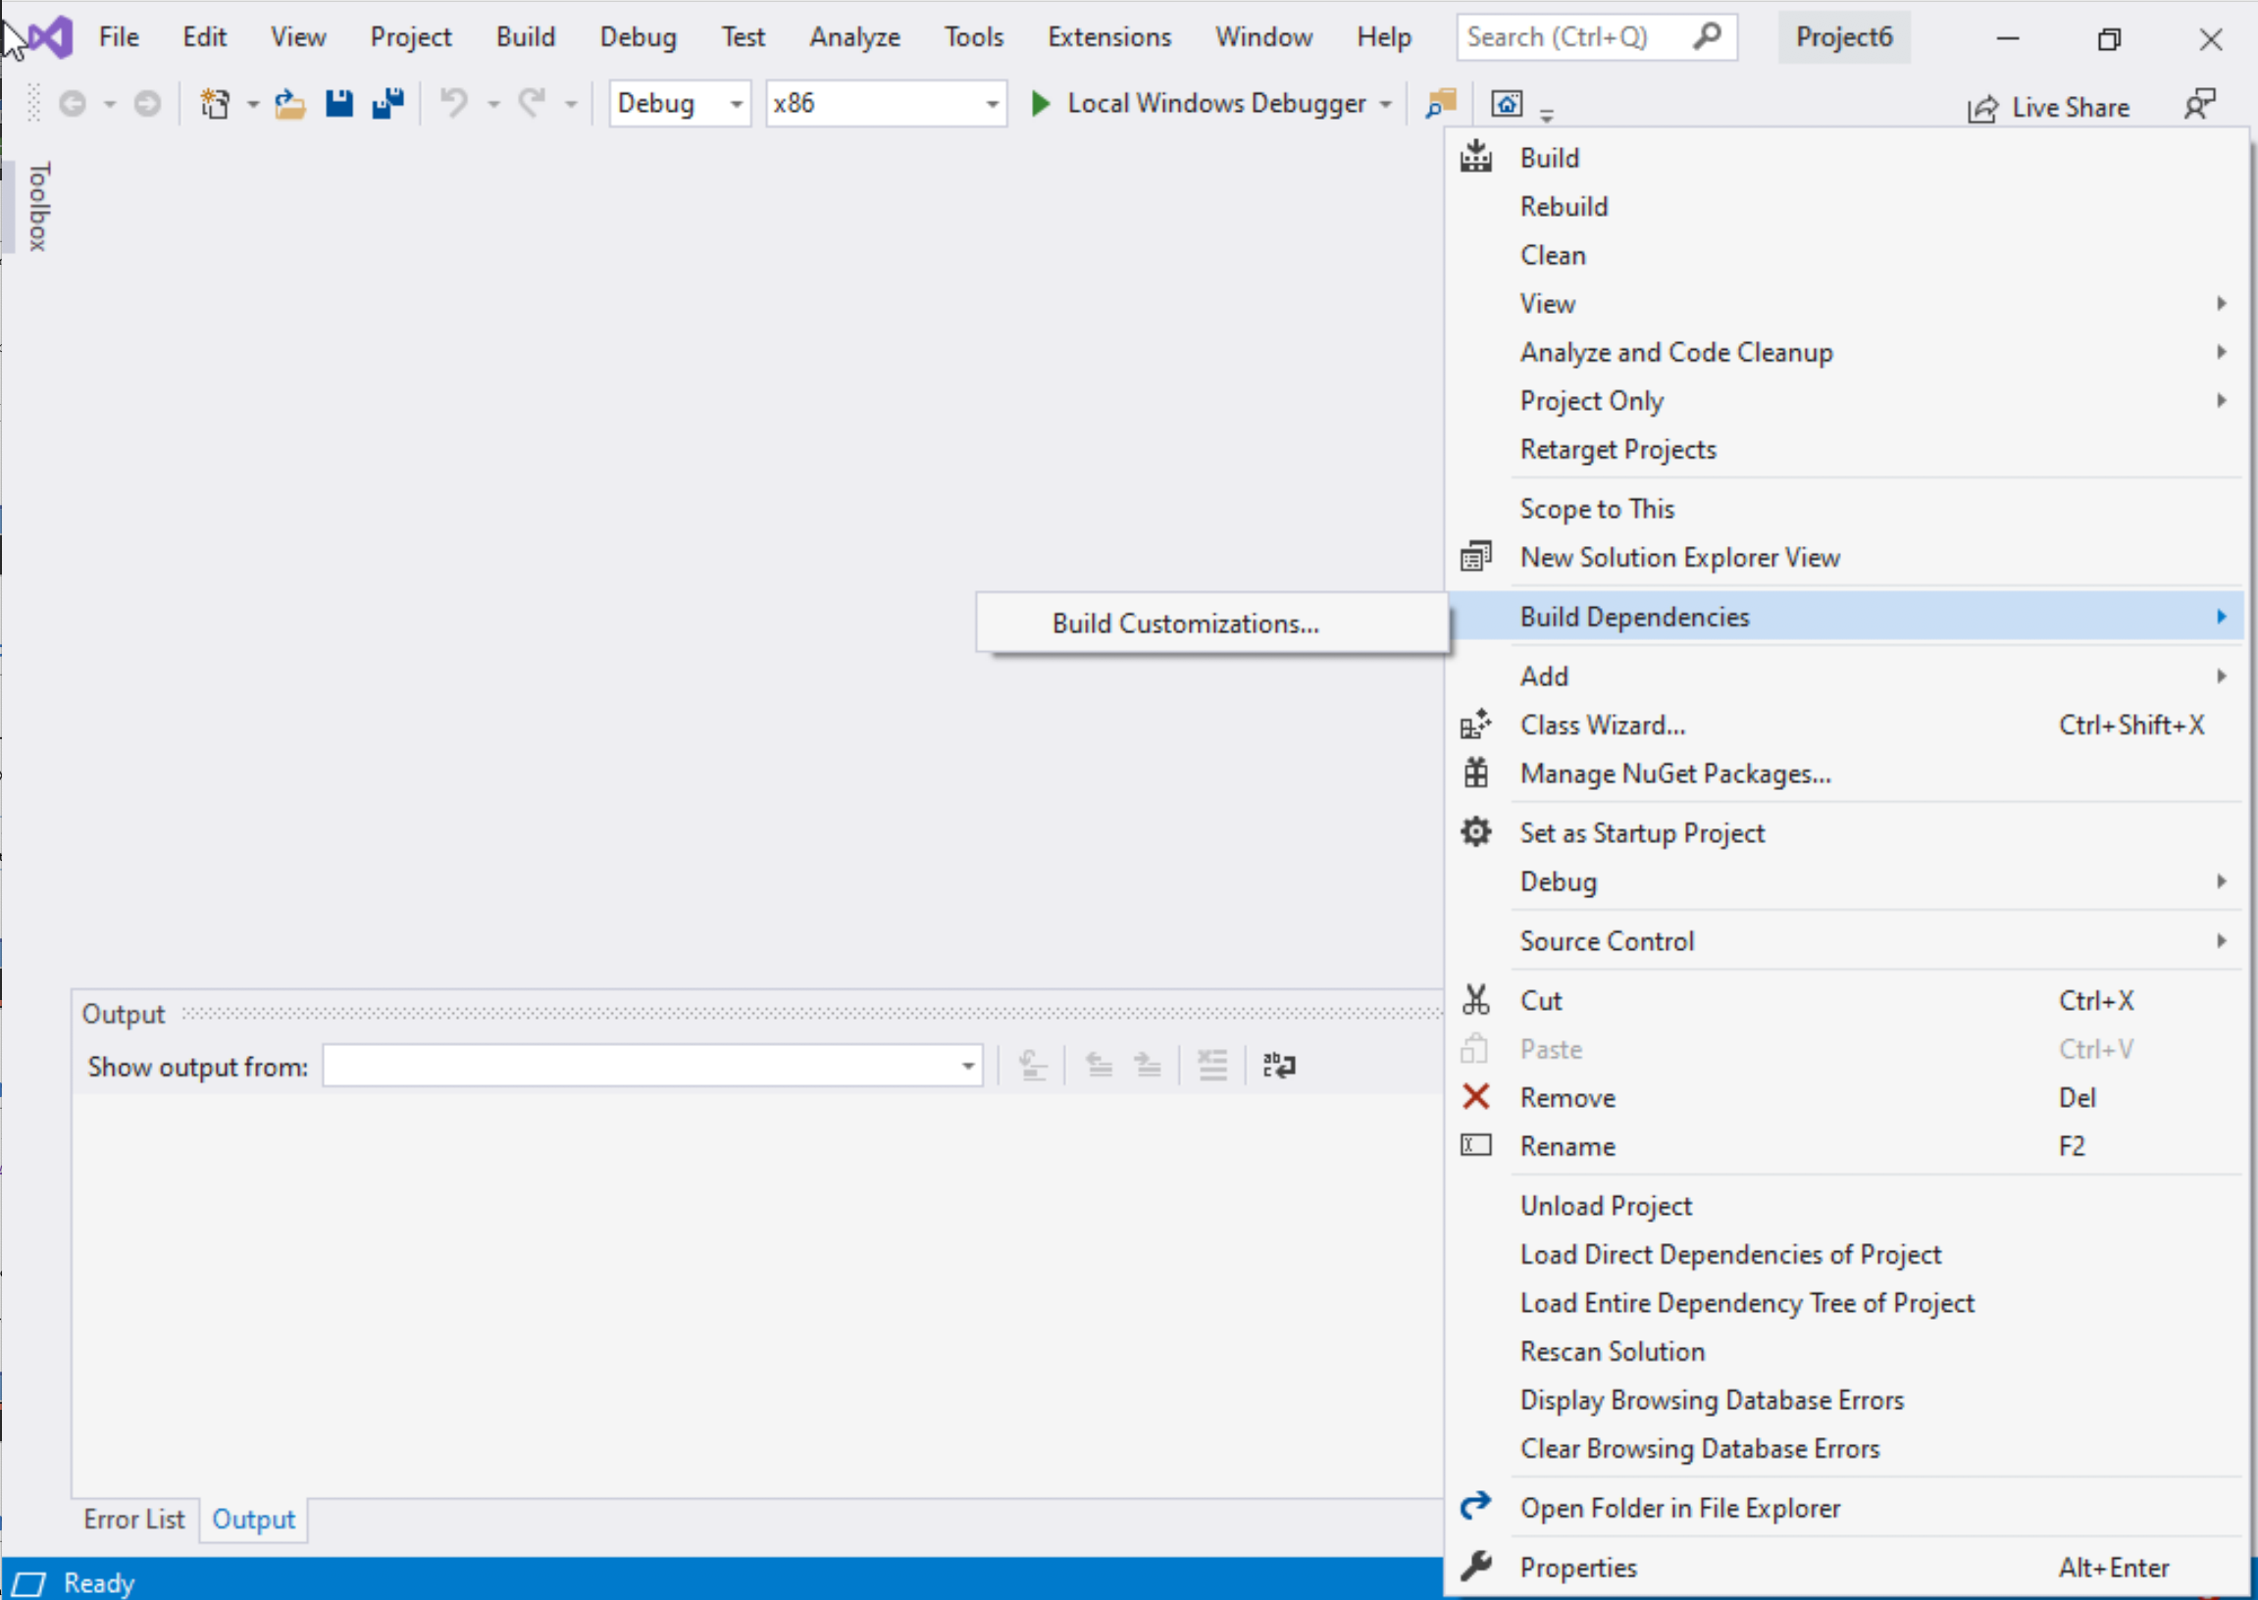
Step 1: Create a project (6)
Select Project Name on solution explorer
Right click on it
Go to Build Dependencies
Click on Build Customizations

Slide 25
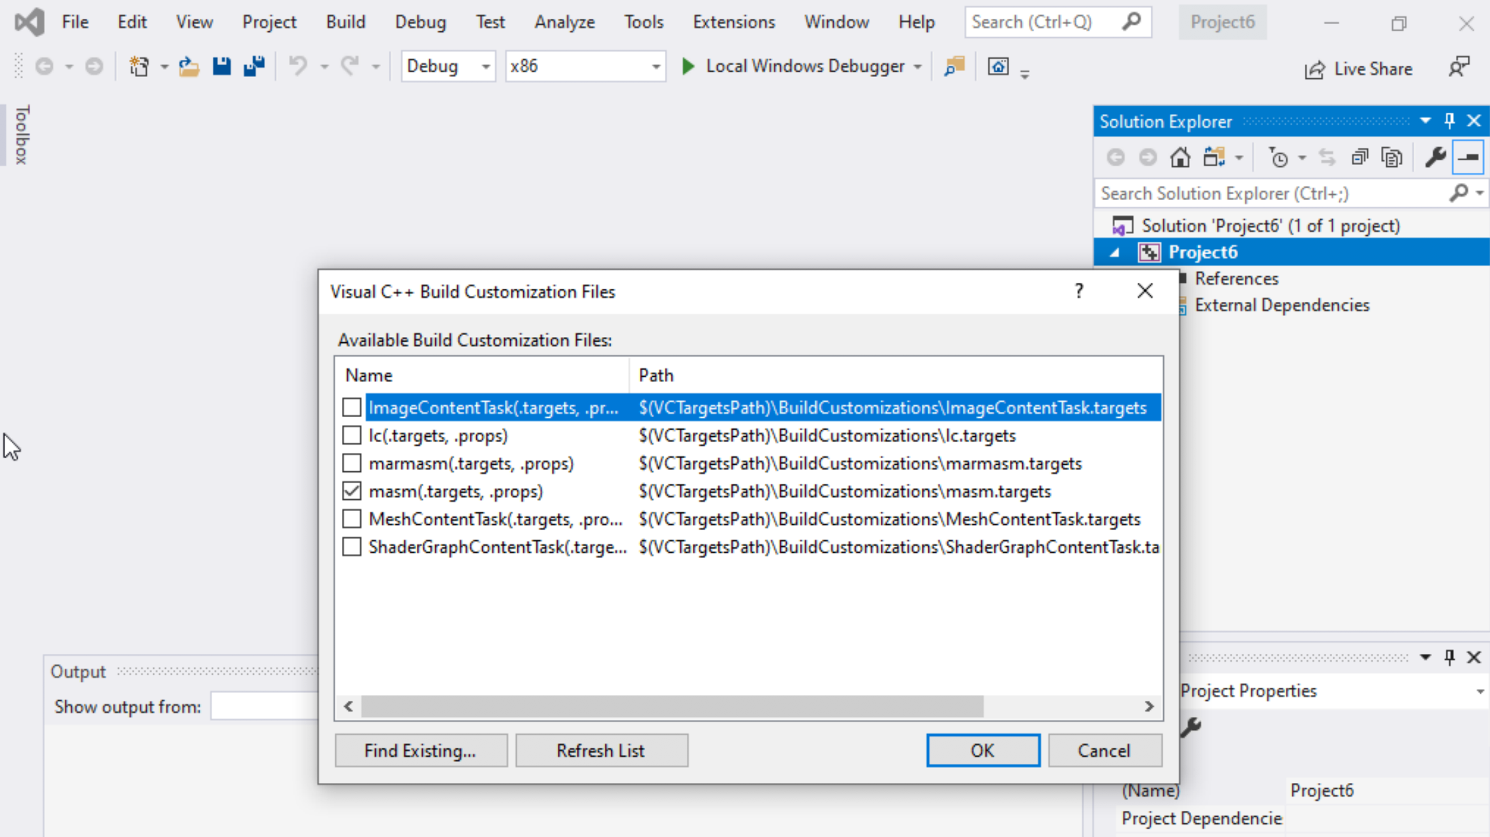
Step 1: Create a project (7)
Select masm(.target, .props)
Click ok

Slide 26
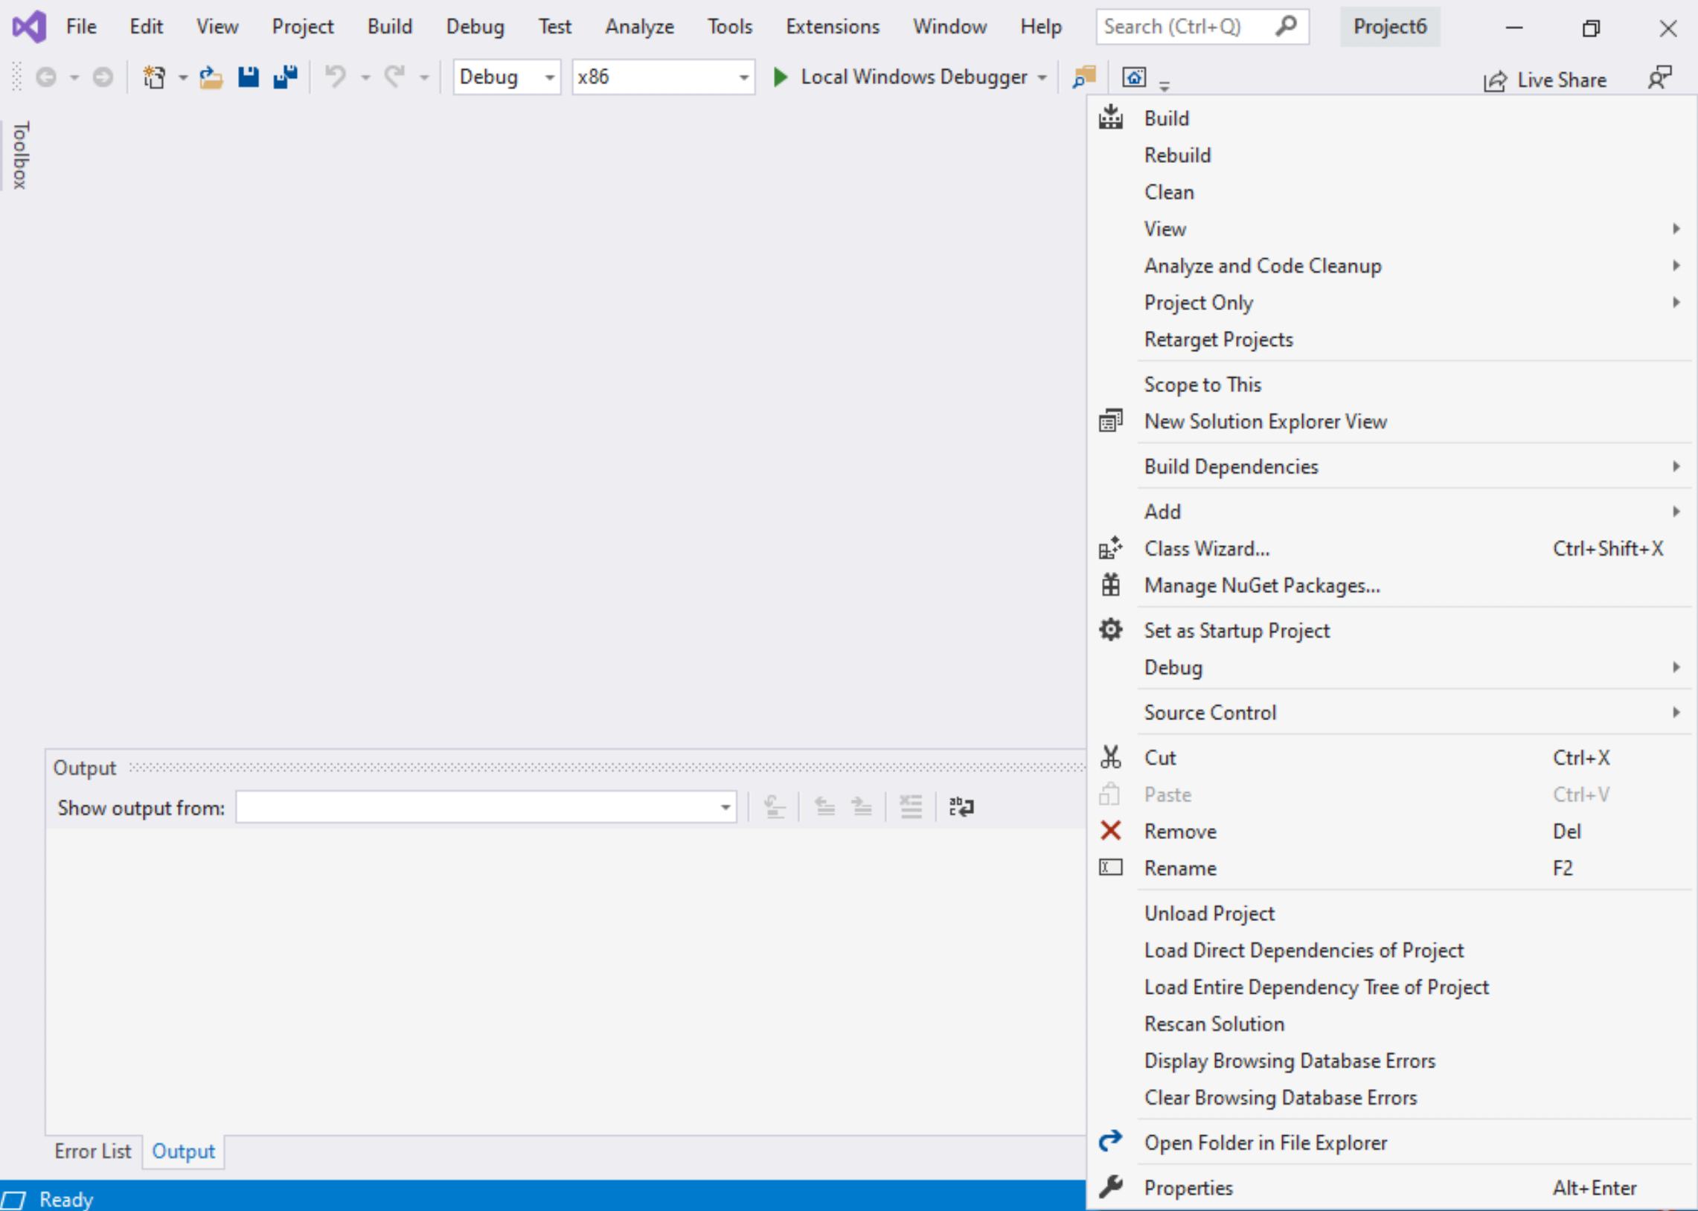
Step 1: Create a project (8)
Right click on the Project name in the solution explorer
Click properties

Slide 27
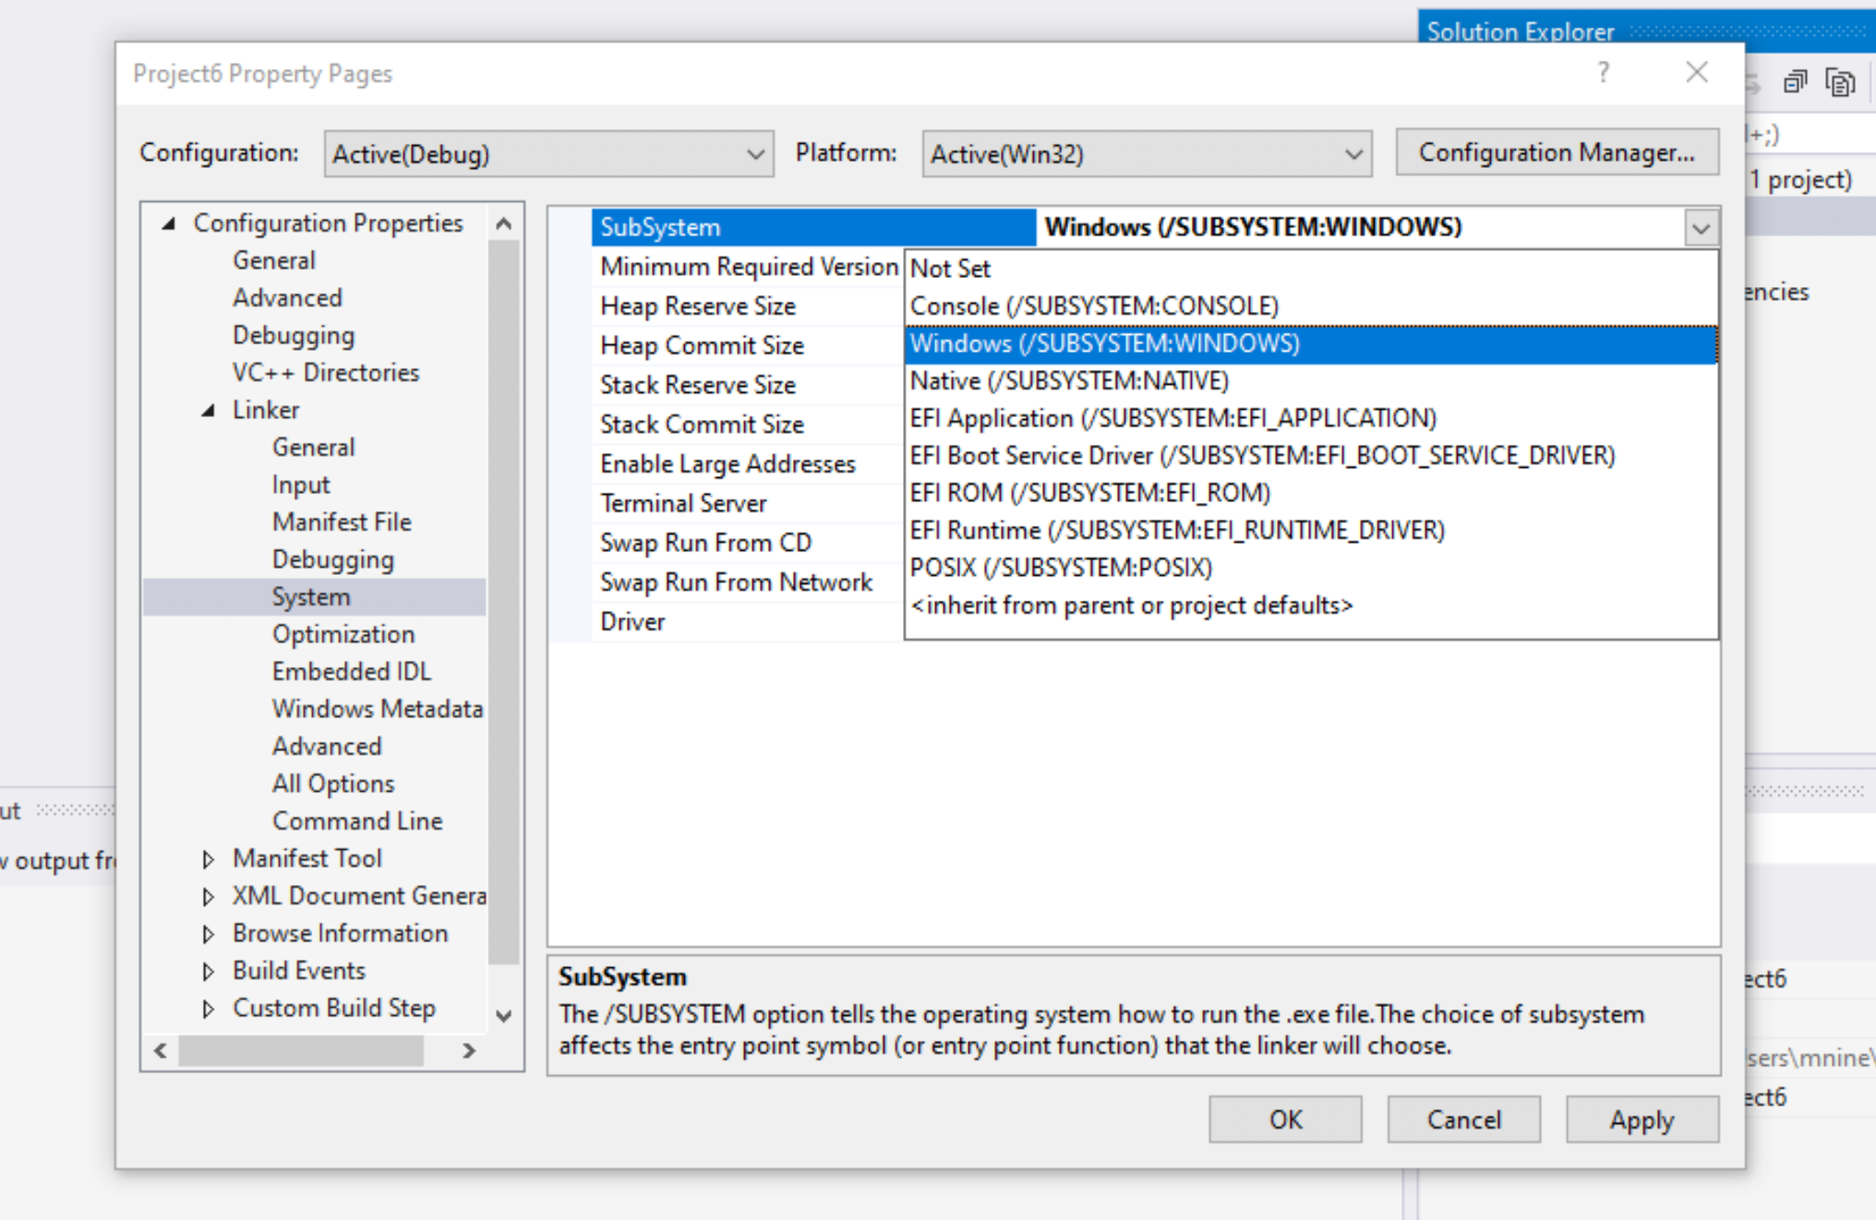

Step 1: Create a project (9)
Expand the ‘Linker’
Select ’System’
Select Windows(/SUBSYSTEM:WINDOWS)
Click OK

Slide 28
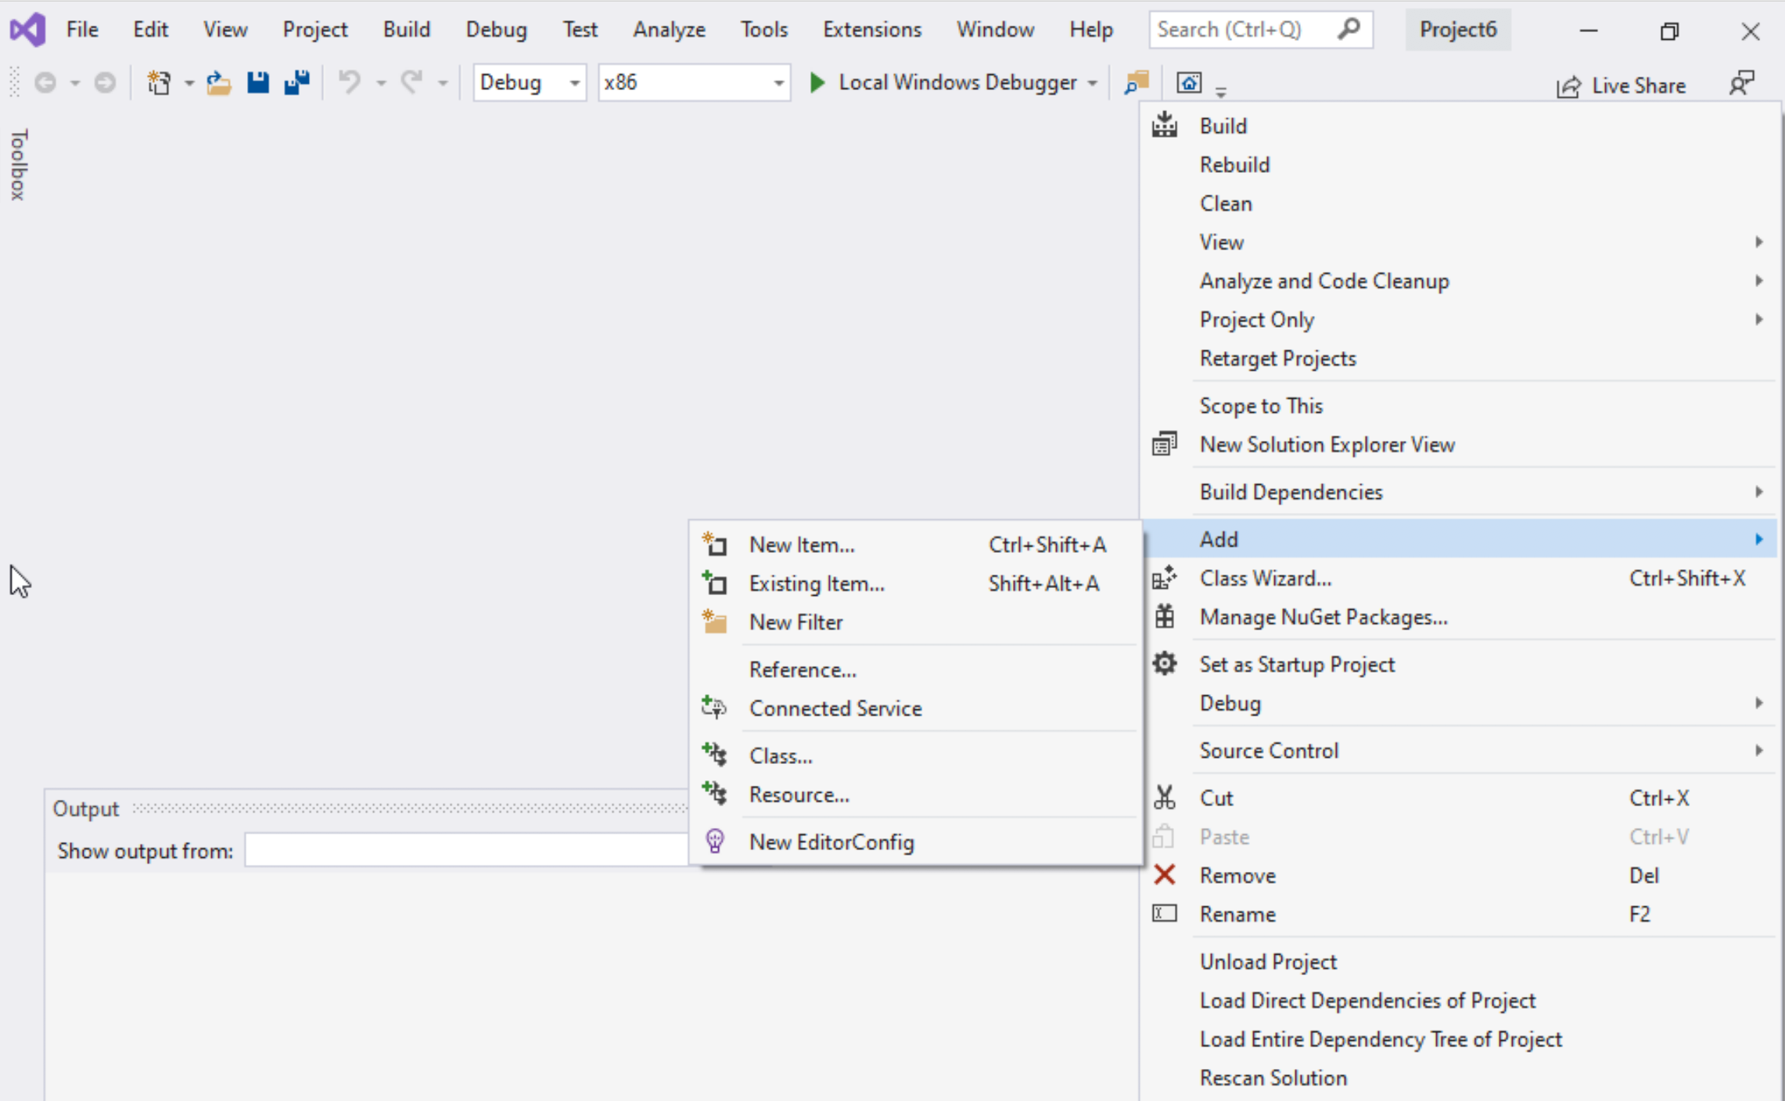
Step 1: Create a project (10)
Select Project name on solution explorer
Right click on it
Expand Add
Choose New Item

Slide 29
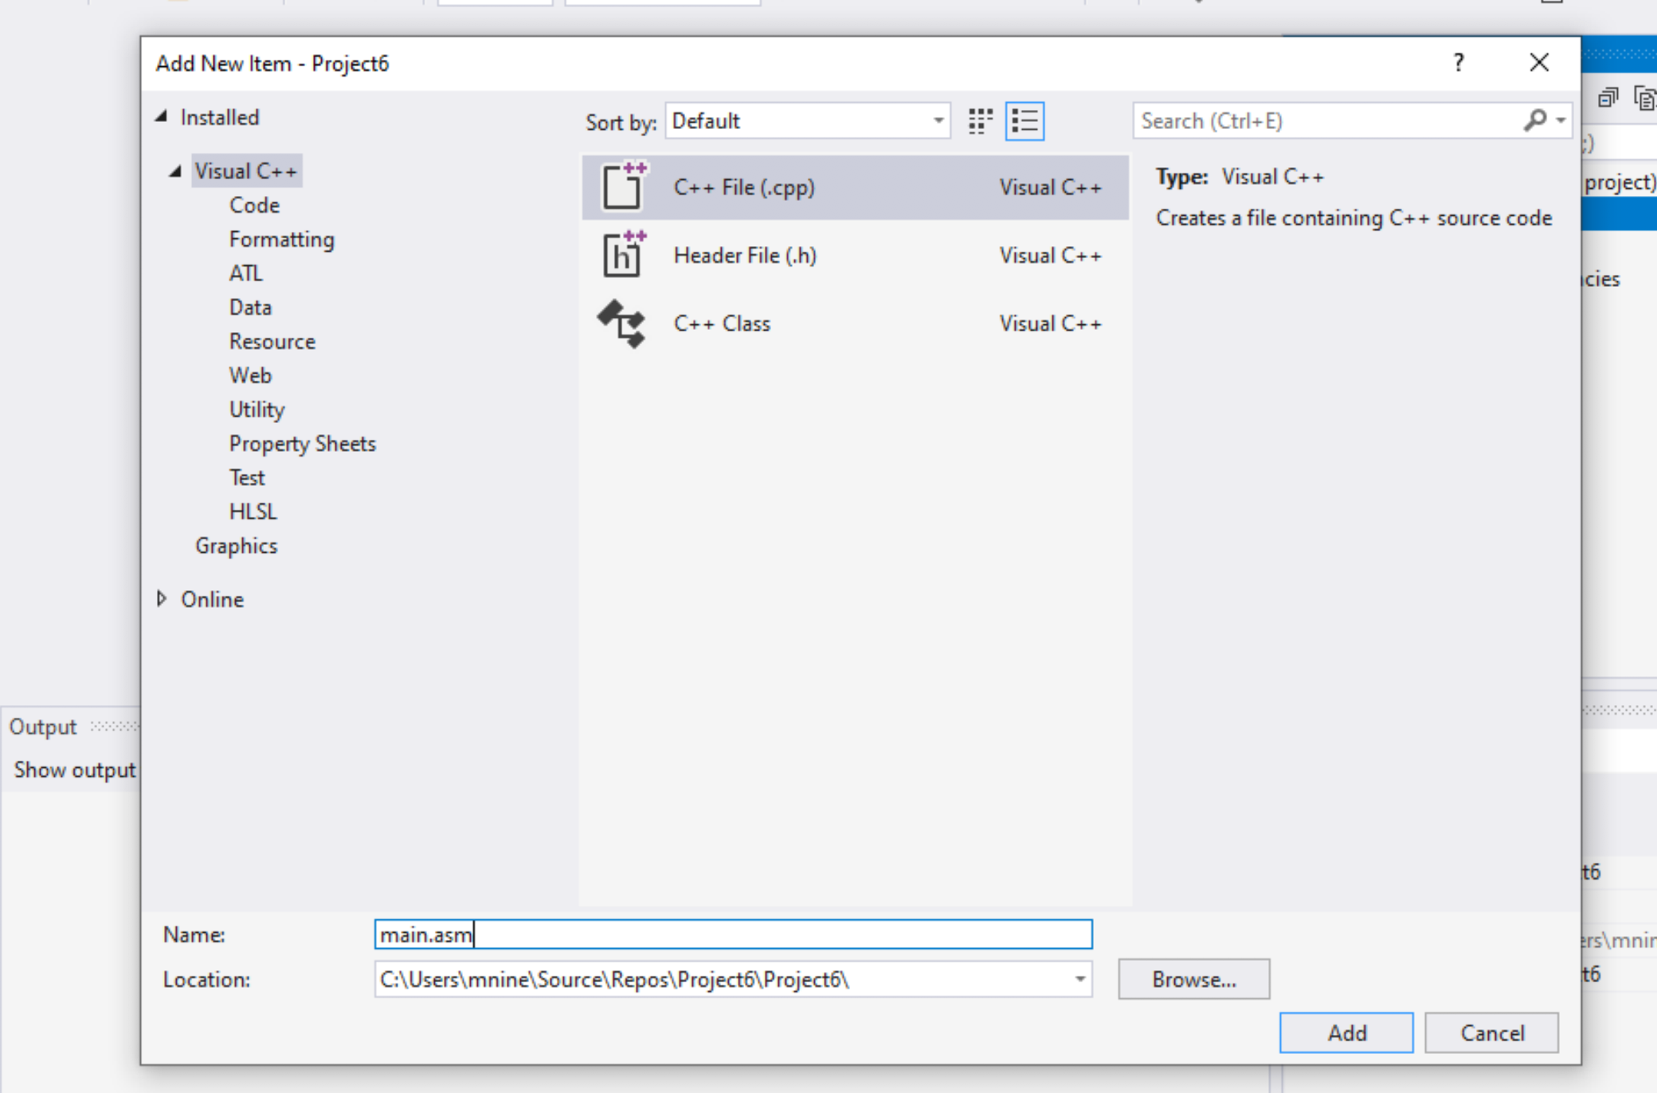


Step 1: Create a project (11)
Select C++ File(.cpp)
Name: main.asm
Click Add

Slide 30
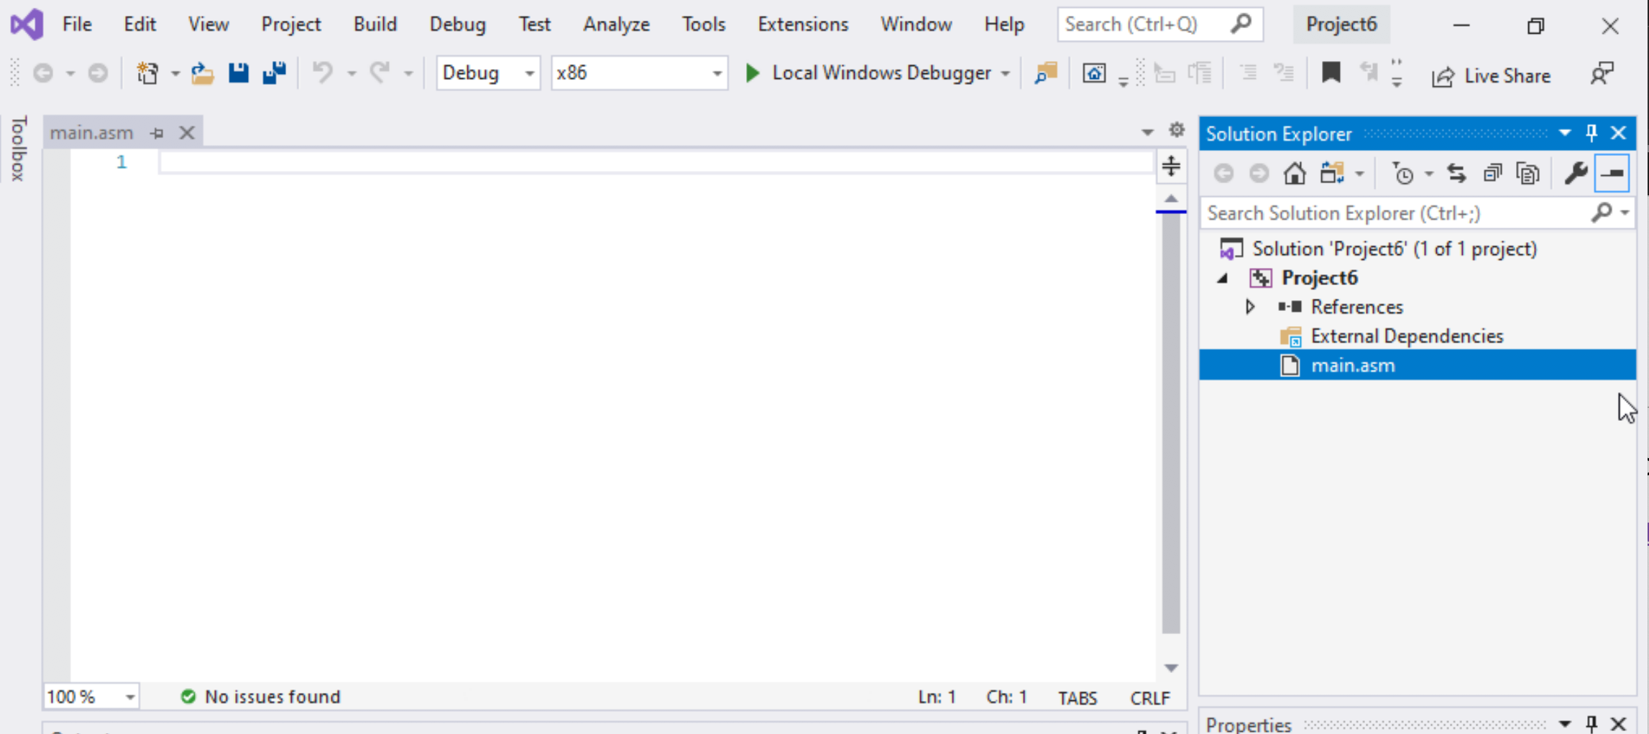

Step 1: Create a project (12)
Select main.asm
Add your code
In the main.asm File.

